Slide 1
Erasmus' projects
Step 1: Preparatory Work for Reception and Mobility
Ladies Barbalic, Campilla, Cid, Accriz et Mister Garde
T PCOM & TPVEN
2022/2023

Slide 2
Summary of tasks to be performed
September 2022 project ;
The calendar ;
Formation of pairs ;
Lexical research : GOODIES
Conducting research from the various websites (www.initiatives.fr / https://www.objetrama.fr / www.cadencom.com / www.goodiespub.fr / https://atelierbox.fr / www.very-good-factory.com / www.smart-goodies.com / www.netbooster.fr / https://cadoetik.com )
Oral presentation of his/her choice in the form of a powerpoint (work assessed in professional technique according to the grid given in annex)
End of step 1

Slide 3
1) Project step 1
The Lycée Marillac of Perpignan is involved in two European Erasmus projects:
1) European Partnership K220 (Head of T PCOM TPVEN classes for 2023 validated by the management)
And
2) Erasmus Mobility for Teachers and Students (PFMP / Training periods)
The students of the Terminales Commerce and Sales will have to carry out various tasks during the year. Tasks that will enrich your MAJOR WORK, which is a test for the Bac!
Ladies Accriz, Barbelic, Campilla, Cid, and Mister Garde will guide you on this path...
We start this Monday 5th September with a preliminary work on communication.
The school will welcome our Turkish, Spanish and Portuguese partners in April 2023: 100 people concerned (K220 programme).
The school will send teachers and students to Europe on internship and training programmes: 30 people involved.

Slide 4
Project STEP 1 (continued)
We need to communicate:
The team of teachers decided to start with an assignment on GOODIES!
You will have to find THE right goodies for each situation:
1) For the K220 project, you will have to find a goodie that is more about the idea of a Gift to be given to the young people who will come (as well as the Marillac students) in April for the last mobility Partnership!
The quantity to be planned is 100 goodies.
2) For the Internship project, Training find a goodie that is more about something useful, practical to give to the participants.
The quantity to be planned is 30 goodies
This work will be the subject of a collective choice via an electronic vote at the end of September 2022!
But of course you are in your baccalaureate year, you will have to present your choice of GOODIES to Mrs Barbelic, Mrs Campilla and Mr Garde in an oral presentation using the SPICMSE technique and with the help of a digital support of your choice compatible with the school's tools.

Slide 5
2) CALENDAR of step 1
For the TPVEN and TPCOM we will talk in week because the hours of teachers and the schedules are different!
Week Monday September 5th : Constitution of pairs / Research
Week Monday September 12th : Research in autonomy and guided (TPVEN because Mr. Garde is in mobility)
Week Monday September 19th : Realization of the digital support;
Week Monday September 26th : Oral presentation (We will deposit the works on a classroom of Mrs Campilla (teacher having the 2 classes) each one will go to see the goodies and the arguments Soncase
Week Monday October 3rd : Choice of Goodies / Step 2

Slide 6
3) Constitution of the pairs
The most important thing is to work with someone who will give you something and with whom you can easily exchange!
Keep in mind that you are preparing the masterpiece for the exam ! In addition, you will have a grade for your semester and therefore your "Parcours Sup"!
6 pairs in T PVEN
6 pairs in T PCOM

Slide 7
4) Lexical research
This assignment will be the subject of a handout/slide during your presentation;
Define the term GODDIES;
Interest for companies and associations for these objects.

Slide 8
5) Internet research
On the following sites you will have to select 2 goodies for the 2 types of project:
1) 100 "gift" goodies for the K220 project;
2) 30 "practical" goodies for the mobility projects.
Websites :
www.initiatives.fr
https://www.objetrama.fr
www.cadencom.com
www.goodiespub.fr
https://atelierbox.fr
www.very-good-factory.com
www.smart-goodies.com
www.netbooster.fr
https://cadoetik.com

Slide 9
6) Carrying out the work :
You have found the two goodies that best meet the expectations.
You will use the SIPCMSE technique to present each product.
Your work will include :
A presentation "page" with :
A tagline of your choice
Erasmus logos (twinspace)
Your name and class and school
Photos of the products
"page" Contents
"page "Lexical research: Goodies + Illustration of your choice
"page" SPICMSE 1 sheet : Goodies 1
"page" SPICMSE 2 sheet: Goodies 2
"page" sources

Slide 10
7) Oral presentation of the work
You have now done your work. You have made a note of it.
Now you will have to present it. The oral presentation is an important part of the presentation of the work. You will therefore receive a second mark.
You will find the evaluation grids for the work to be handed in and for the oral presentation below:
The digital version must be given to Mr Garde, Mrs Cid and Accriz (T PVEN) and Mrs Barbalic, (T PCOM)

Slide 11
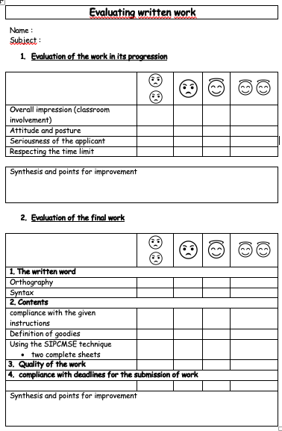
Written grid
Score out of 20 :

Slide 12
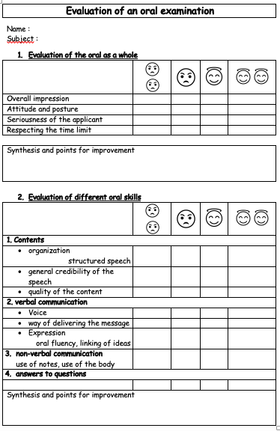
Grid for the oral test
Score out of 20 :

